Slide 1
Dimensionality reduction: PCA and kernel PCA
Special session of 2019 GLBIO conference at Madison, Wisconsin
Presenter: Xiaotong Liu
Chad Myers lab, University of Minnesota

Slide 2
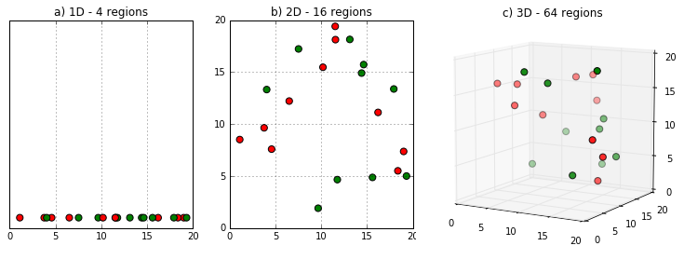
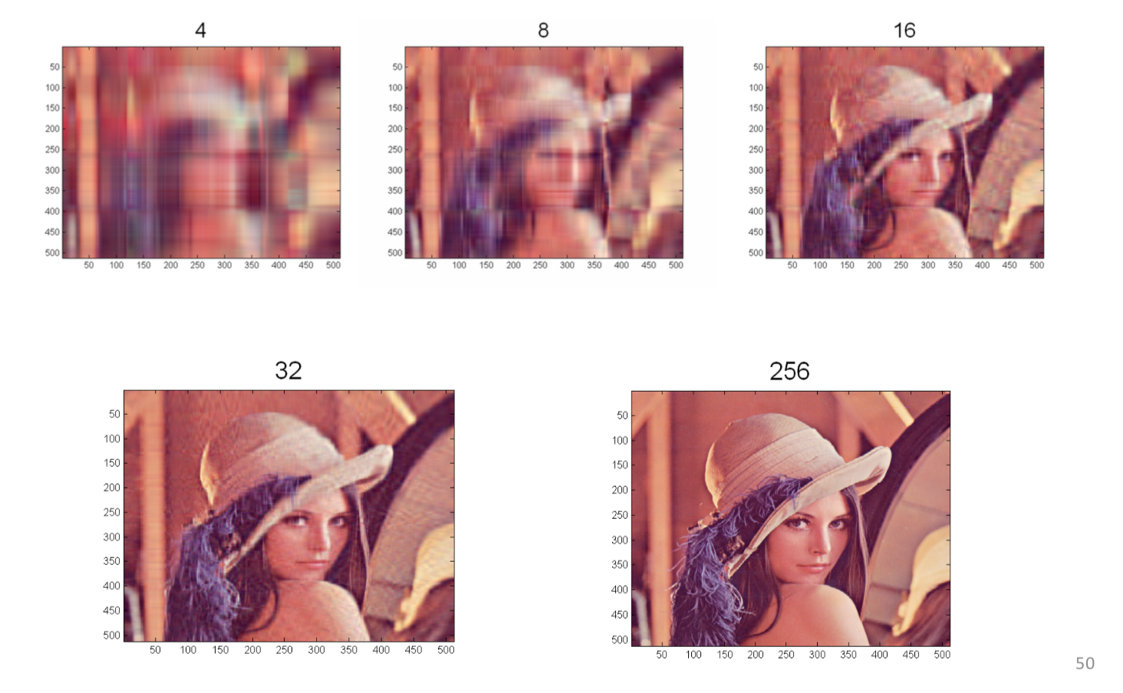
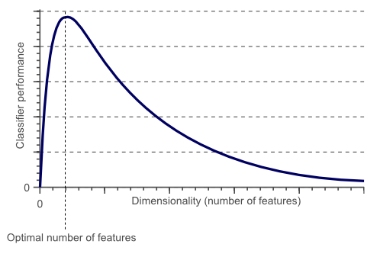
Dimensionality reduction
Avoid curse of dimensionality.
Reduce time and memory required by data mining algorithms.
Visualization.
Hughes Phenomenon
(Prasad Pore, from KDnuggests post)
(Badreesh Shetty, from Towards Data Science post)
Notes:
As the dimension grows, there will be exponential increase of the volume of hyperspace, resulting in sparsity of data.
Hughes Phenomenon shows that as the number of features increases, the classifier’s performance increases as well until we reach the optimal number of features. Adding more features based on the same size as the training set will then degrade the classifier’s performance.

Slide 3
Principle component analysis
Project the data unto a subspace with fewer dimensions, where the majority of the variance can be captured.
y
x’
y’
0
x

Slide 4
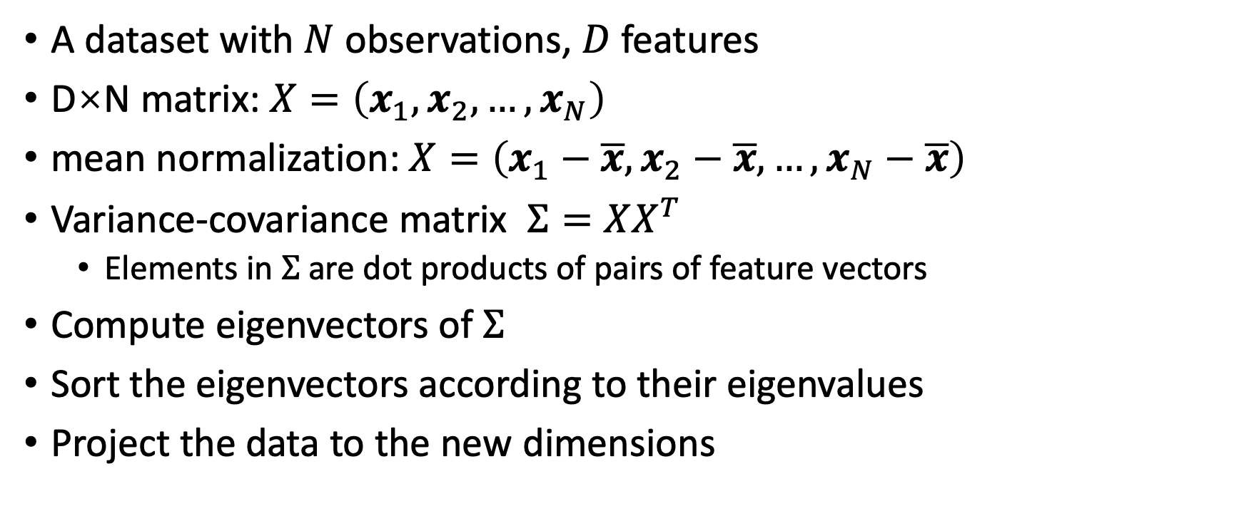
Steps to perform PCA
A dataset with $N$ observations, $D$ features
D×N matrix: $X=\left(x_{1},x_{2},…,x_{N}\right)$
mean normalization: $X=\left(x_{1}−\overline{x},x_{2}−\overline{x},…,x_{N}−\overline{x}\right)$
Variance-covariance matrix $Σ=XX^{T}$
Elements in $Σ$ are dot products of pairs of feature vectors
Compute eigenvectors of $Σ$
Sort the eigenvectors according to their eigenvalues
Project the data to the new dimensions

Slide 5
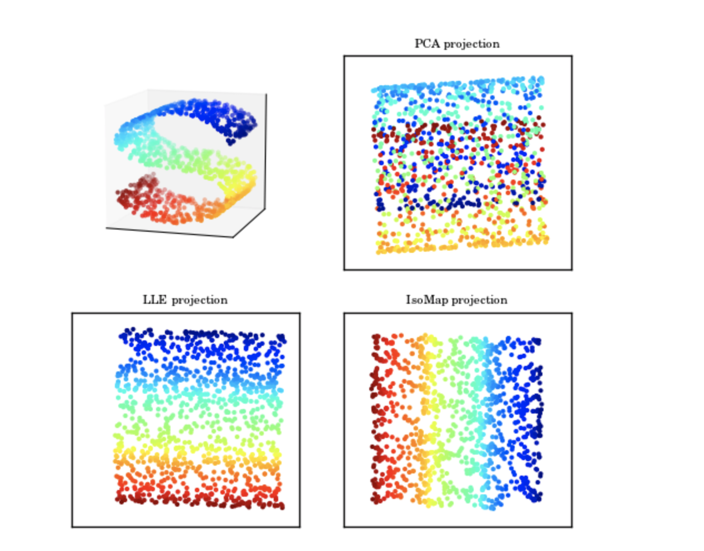
Linear or nonlinear projection?
astrophysics, Vanderplas et al, proc. of CIDU, pp. 47-54, 2012

Slide 6
Kernel PCA
Conventional PCA projects the data to linear subspace.
But linear subspace may not efficiently capture the variance in the data.
y
-2
-1
1
2
x
1
2
x² + y²

Slide 7
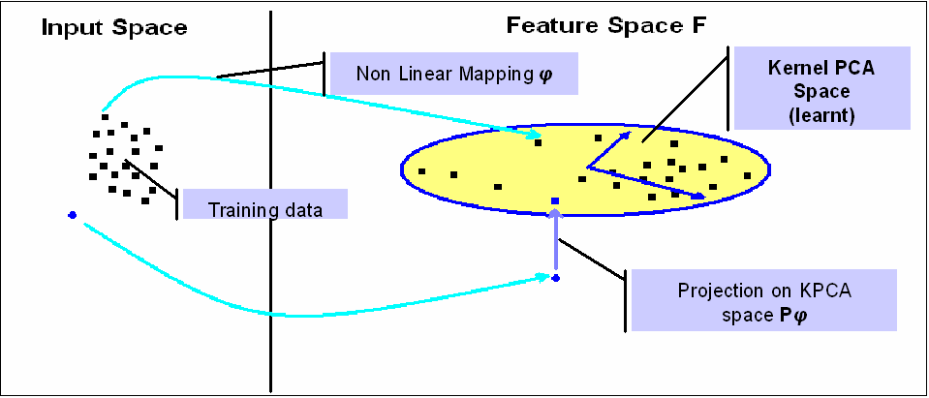
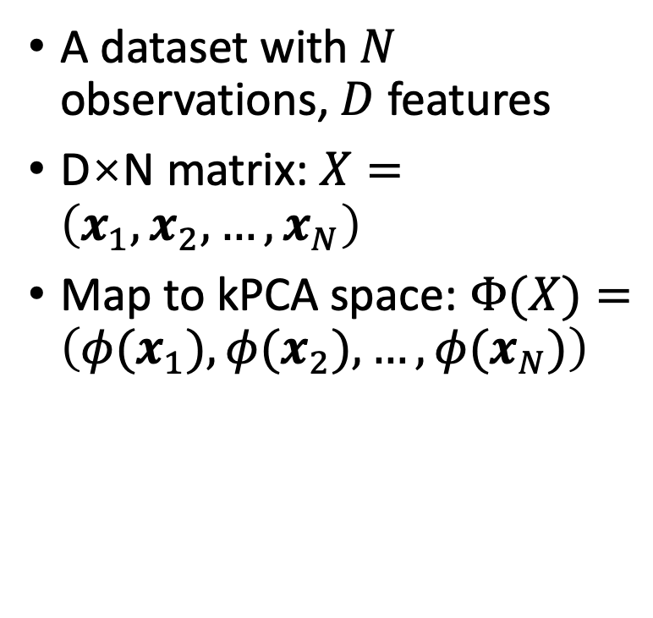
Idea of kernel PCA
A dataset with $N$ observations, $D$ features
D×N matrix: $X=\left(x_{1},x_{2},…,x_{N}\right)$
Map to kPCA space: $Φ(X)=\left(φ(x_{1}),φ(x_{2}),…,{φ(x}_{N})\right)$
na-mic.org

Slide 8
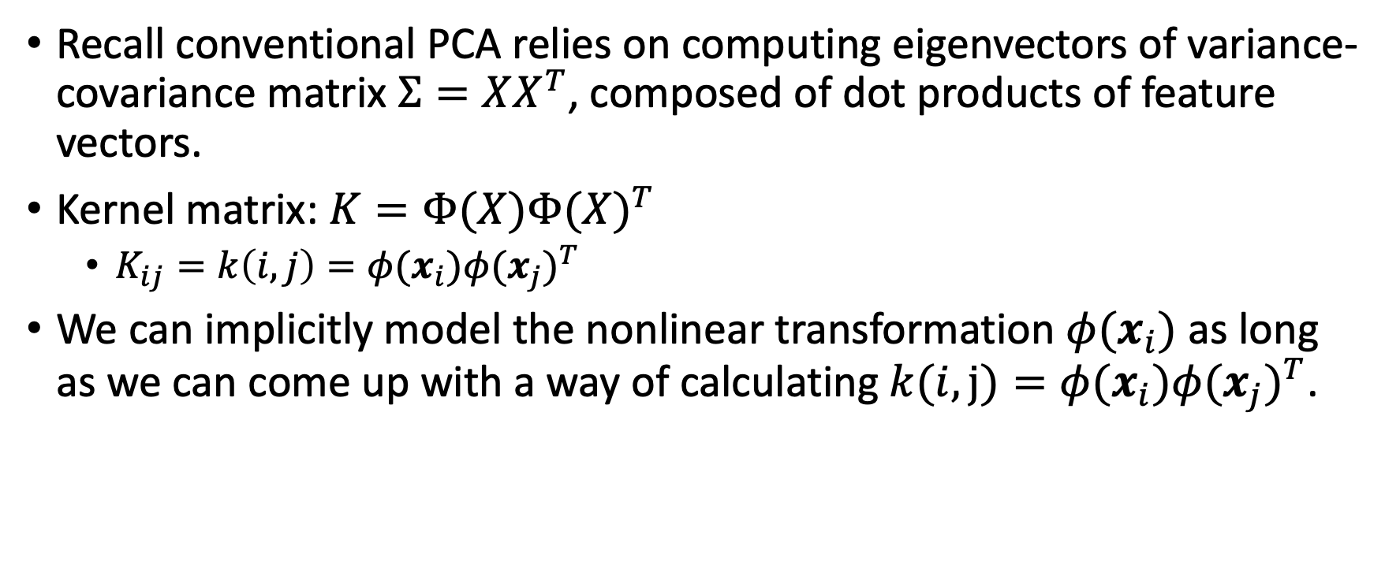
The “kernel trick”
Recall conventional PCA relies on computing eigenvectors of variance-covariance matrix $Σ=XX^{T}$, composed of dot products of feature vectors.
Kernel matrix: $K=Φ(X){Φ(X)}^{T}$
$K_{ij}=k\left(i,j\right)=φ(x_{i}){φ(x_{j})}^{T}$
We can implicitly model the nonlinear transformation $φ(x_{i})$ as long as we can come up with a way of calculating $k(i,j)=φ(x_{i}){φ(x_{j})}^{T}$.
David Thompson, JPL-Caltech Virtual Summer School, Big Data Analytics

Slide 9
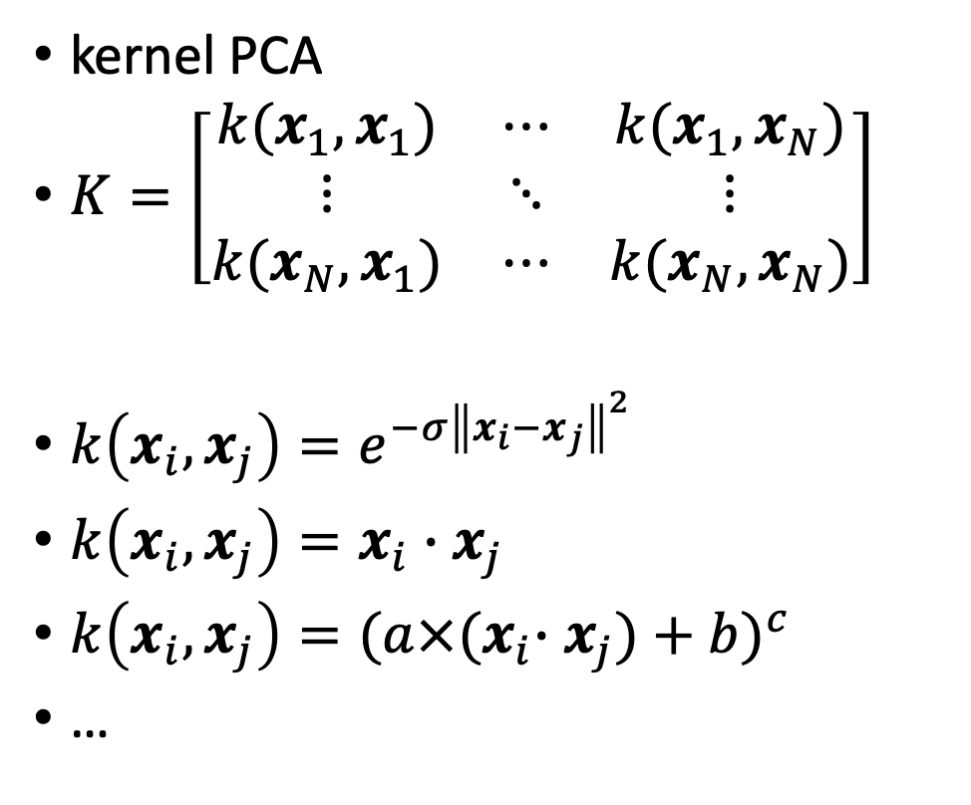
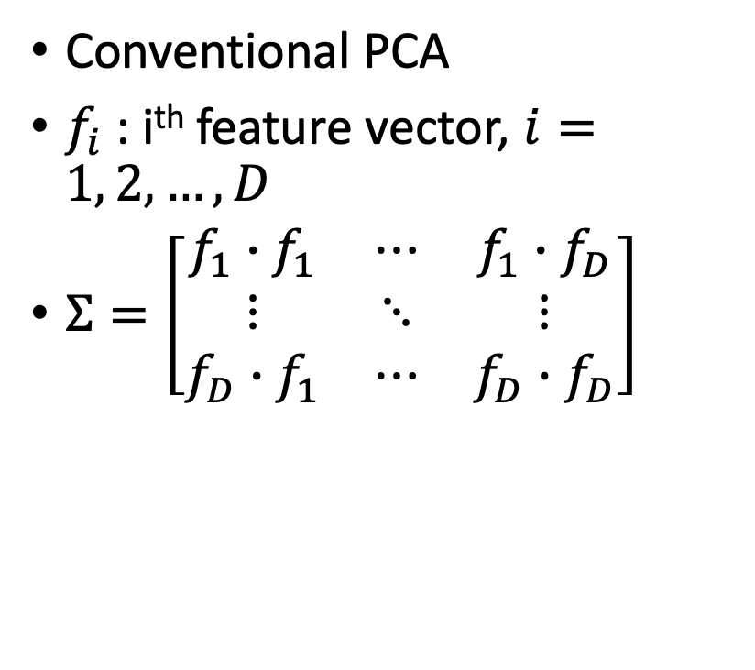
Kernel matrix
Conventional PCA
$f_{i}$ : i^{th} feature vector, $i=1, 2,…,D$
$Σ=\left[\begin{matrix}f_{1}∙f_{1} & ⋯ & f_{1}∙f_{D} \\ ⋮ & ⋱ & ⋮ \\ f_{D}∙f_{1} & ⋯ & f_{D}∙f_{D}\end{matrix}\right]$
kernel PCA
$K=\left[\begin{matrix}k(x_{1},x_{1}) & ⋯ & k(x_{1},x_{N}) \\ ⋮ & ⋱ & ⋮ \\ k(x_{N},x_{1}) & ⋯ & k(x_{N},x_{N})\end{matrix}\right]$
$k\left(x_{i},x_{j}\right)=e^{−σ{\left\|x_{i}−x_{j}\right\|}^{2}}$
$k\left(x_{i},x_{j}\right)=x_{i}∙x_{j}$
$k\left(x_{i},x_{j}\right)={{(a×(x}_{i}∙x_{j})+b)}^{c}$
…

Slide 10
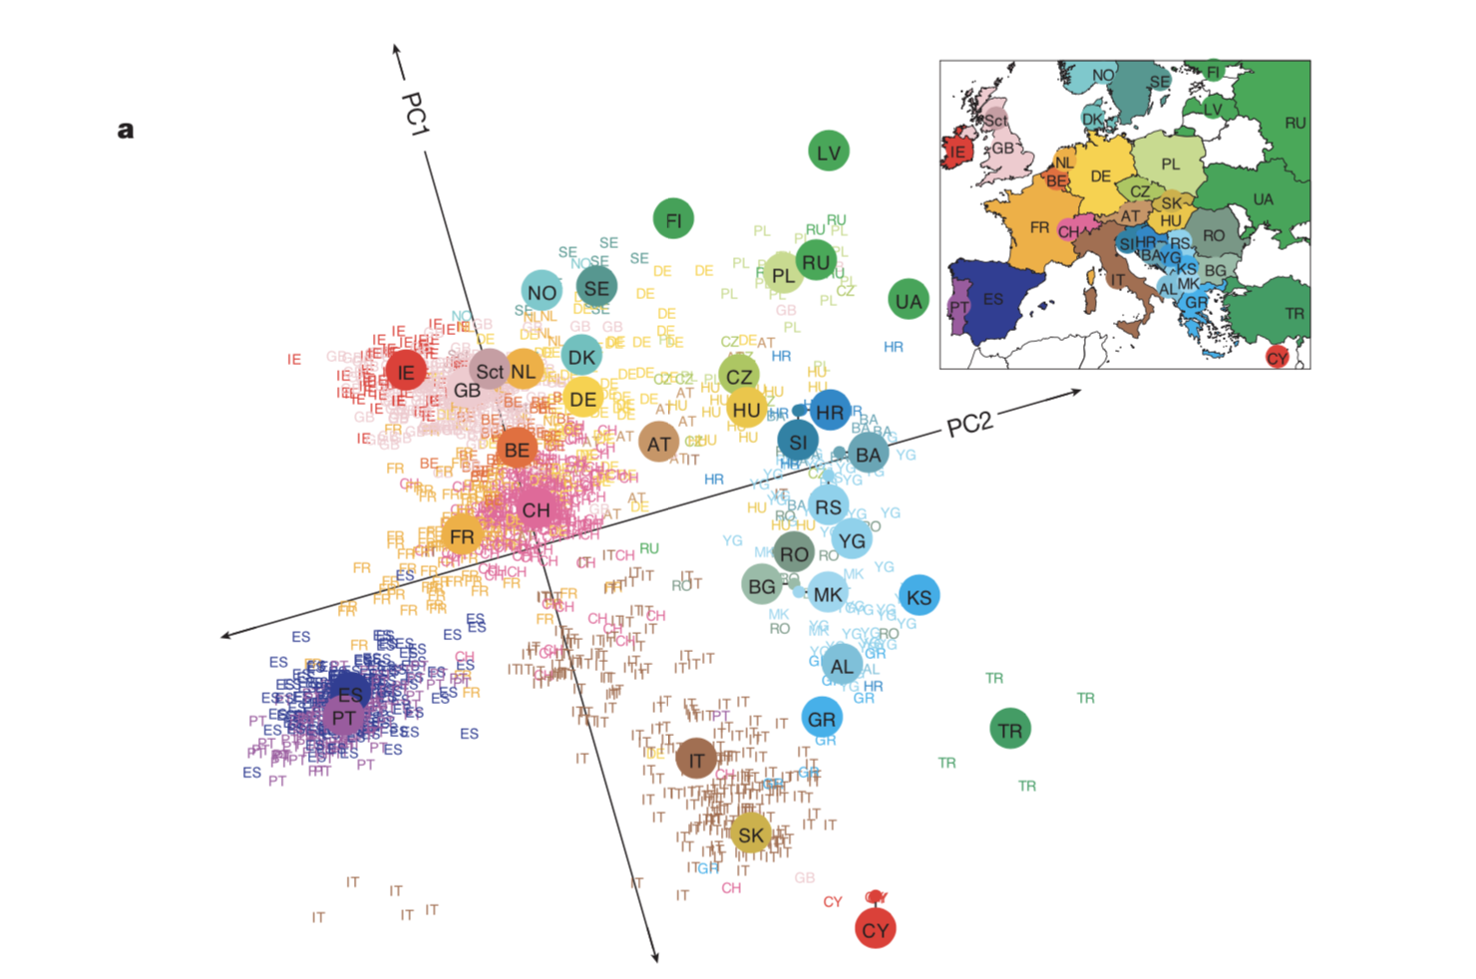
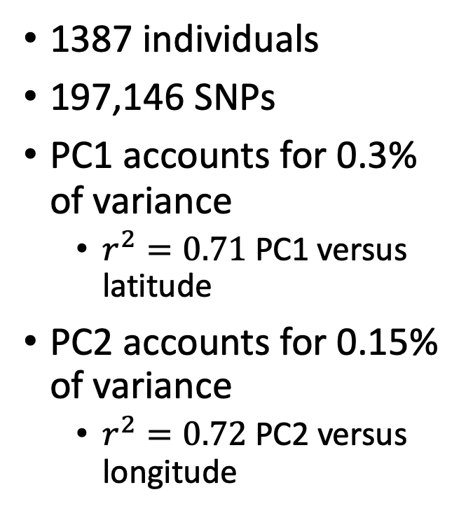
Applications: tracking geography
1387 individuals
197,146 SNPs
PC1 accounts for 0.3% of variance
$r^{2}=0.71$ PC1 versus latitude
PC2 accounts for 0.15% of variance
$r^{2}=0.72$ PC2 versus longitude
Novembre, John, et al. "Genes mirror geography within Europe." Nature 456.7218 (2008): 98.

Slide 11
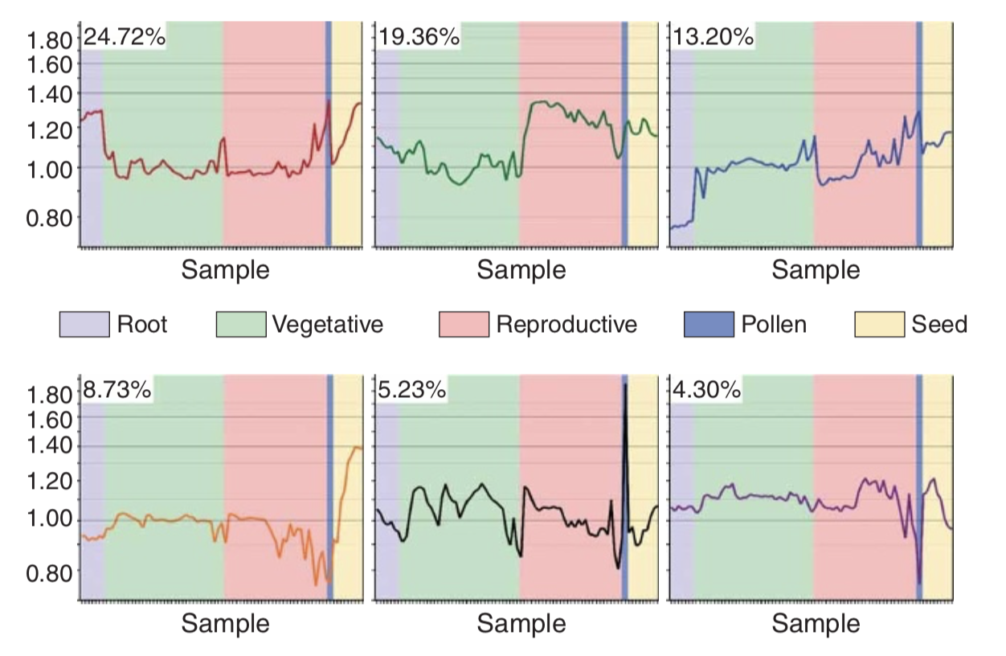
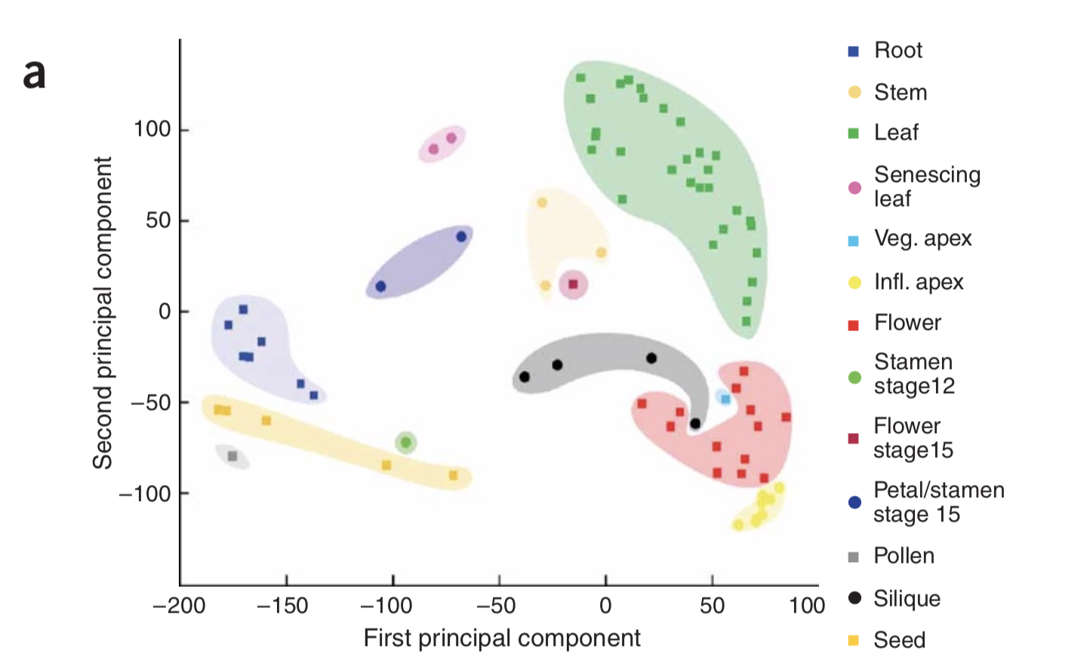
Applications: tracking development/morphology
22746 genes
79 samples
3 replicates each
kernel PCA
linear kernel function
Overall morphological similarity was well reflected in PCA distances.
The top 6 PCs account for 75% of the variance and highlight four developmental distinctions.
Schmid, Markus, et al. "A gene expression map of Arabidopsis thaliana development." Nature genetics 37.5 (2005): 501.a

Slide 12
Applications: tracking the time course
Transcriptomes profiled during the plant immune response at seven different time points post the stimulus infection
2066 genes
119 samples
3 replicates each
clear temporal trajectory

